Slide 1

AI Tools: Projects, Gems & Custom GPTs
Feature Comparison & Use Cases
August 12, 2025

Slide 2
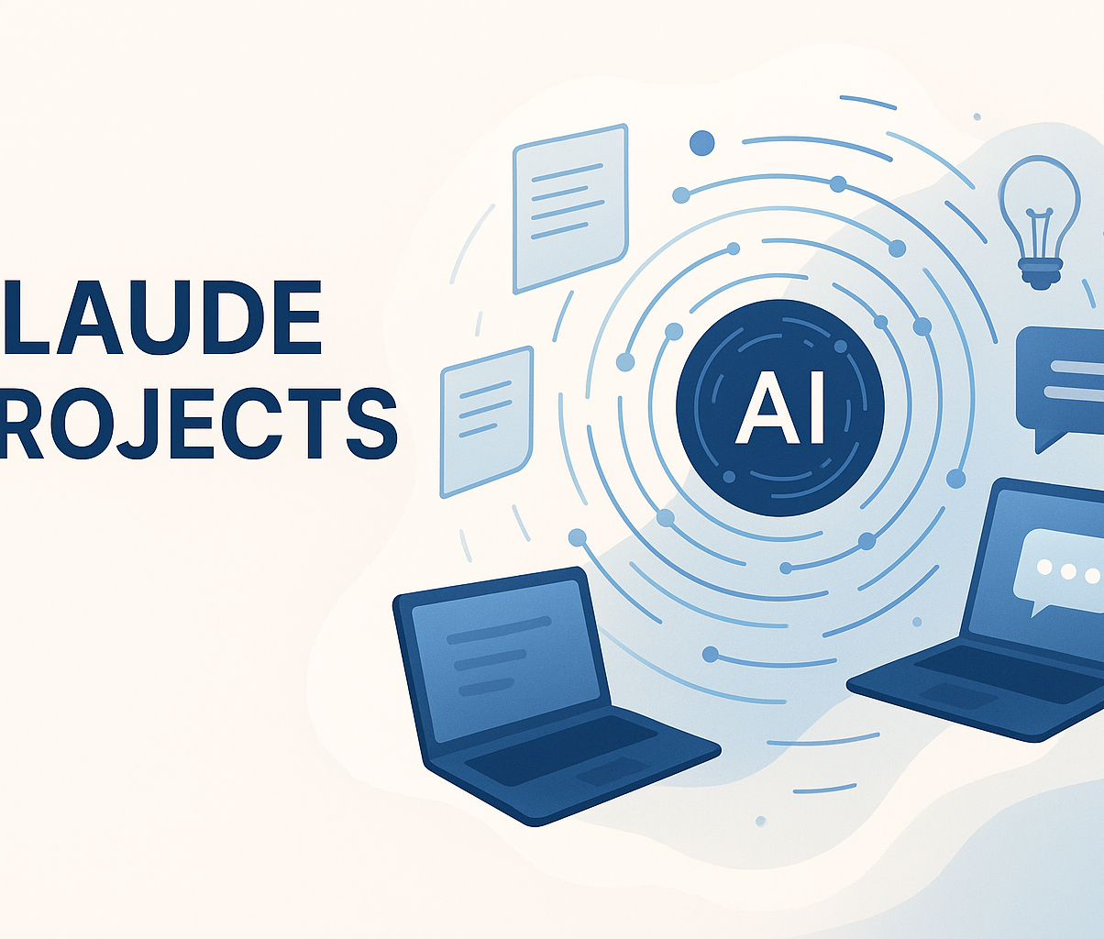
Claude Projects
Organize chats & knowledge into projects
200K-token context window (~500 pages) for documents, code & transcripts
Custom instructions per project tailor responses
Share snapshots & activity feed to inspire teammates
Data & chats not used for training without explicit consent
[1] [2] [3] [4] [5]

Slide 3

Gemini Gems
Build custom chatbots with your own instructions & knowledge files
Define instructions & upload files; test and refine with Gem builder
Requires a Google account; create/edit on web only; not available for Live or image generation
Example: marketing expert Gem referencing brand guidelines for research & brainstorming
[6] [7] [8] [9]

Slide 4

ChatGPT Projects
Organize AI-assisted work into dedicated projects with chats, files & instructions
Available for Plus, Pro & Teams; view-only on mobile; full support on web & Windows
Create a project: open ChatGPT, click “+”; drag existing chats or start new ones
Add files & custom instructions to guide responses; set tone or citation style
Centralize tools (Canvas, voice mode & search) to keep drafts, research & final versions linked
[10] [11] [12] [13] [14]

Slide 5



Custom GPTs
Base model
Custom instructions
Knowledge files
Starts from a pre‑trained ChatGPT base
Define behaviour without code
Upload documents to enrich responses
Tailor to specific domains or contexts where the base model falls short
Build & iterate in the GPT builder – name, description, instructions, upload files; preview & refine
Add capabilities such as web browsing, image generation & code interpreter
Avoid uploading sensitive information; knowledge files are downloadable by users
[15] [16] [17] [18] [19] [20]

Slide 6
Comparative Overview
What's shared across these tools?
All tools allow you to provide context and custom instructions, and most let you upload knowledge files. However, they differ in collaboration, scope, and who can access them.
Feature | Tools with feature
Organize chats/projects & files | Claude Projects, ChatGPT Projects
Custom instructions per workspace | All
Upload knowledge files | All
Large context window (200K tokens) | Claude Projects
Team collaboration & sharing | Claude Projects, ChatGPT Projects
Paid subscription required | All
Build shareable custom chatbots | Gemini Gems, Custom GPTs
[21] [22] [23] [24]

Slide 7
Best Use Cases & Recommendations
Claude Projects
Gemini Gems
Deep knowledge tasks (e.g., long documents, code reviews, legal analysis)
Team collaboration with shared chats & documents
Projects requiring large context windows & strong privacy controls
Personal or departmental workflows in Google’s ecosystem
Reusable assistants for marketing research, coding or support
Rapidly deploy specialized chatbots without code
ChatGPT Projects
Custom GPTs
Organizing multiple chats & files around complex tasks like writing, research or coding
Using multi‑modal tools (Canvas, voice, search) in one workspace
Professionals juggling several concurrent projects who need context persistence
Domain‑specific assistants for education, customer support or internal knowledge
Sharing specialized bots across a team or community
Tasks requiring custom capabilities like browsing, image generation or code
[25] [26] [27] [28]

